Slide 1
Functions

Slide 2
Resources
eBook
Hard Copy book
Visualizing Code tool
Cheat Sheets
*Control click to go to the link.

Slide 3
Functions
Functions are code blocks that perform certain tasks
You have been frequently using functions such as input and print
Python also allows you to create your own which allows you to re-use code
function
argument
print(“Hello”)
print(len(“hello”))
int(input(“How old are you?”))
Notes:
Cheat sheet of built in functionshttps://docs.python.org/3/library/functions.html#min

Slide 4
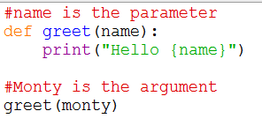
Parameters vs arguments
Parameters and arguments are sometimes used interchangeably but they are different
A parameter is the variable name declared in the definition
An argument is the data we pass into those parameters
Notes:
Cheat sheet of built in functions https://docs.python.org/3/library/functions.html#min

Slide 5
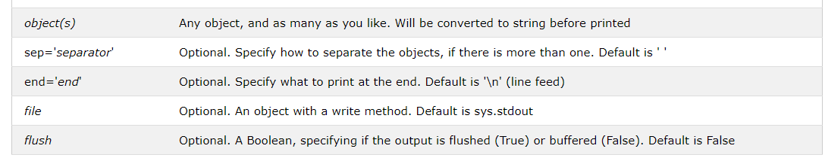
Functions
Lets take a closer look at functions we’re already familiar with: The print function
You can look at the arguments of the print function by running the code print(print.__doc__) or go to the Python documentation website
The print argument takes the arguments
Notes:
https://docs.python.org/3/library/functions.html

Slide 6
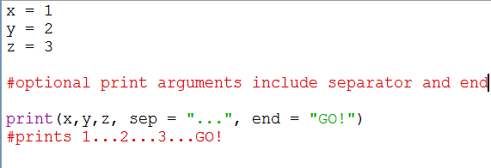
Functions
Functions have default values which we can override.
In the print function, when you don’t specify any value for separator the default is a space.
When you don’t specify a value for end, the default behavior is a new line
Notes:
x = 1
y = 2
z = 3
#optional arguments include separator and end
print(x, y, z, sep = "...", end = "GO!")
#prints 1...2...3...GO!
#Another example is the .pop method. If you don’t enter anything in the parenthesis, it will pop the last value but if you enter pop(3) it will pop the 3rd index

Slide 7
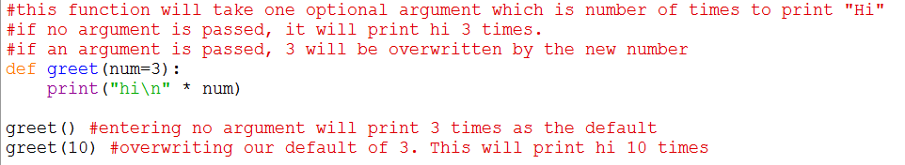
Functions
To specify a default value, simply set it as an equal sign.
This default can be updated later
Notes:
#syntax
#def function_name(arguments):
#what the function does
#this function will take no arguments. it will simply print hello 4 times
def hello():
print("Hello\n"*5)
#this function will take one required argument which is number of times to print "Hi"
def hi(num):
print("hi\n"*num)
#Call the function you created the same way you call pre-built functions
hello() #will print hello 5 times
hi(20) #will print hi 20 times

Slide 8
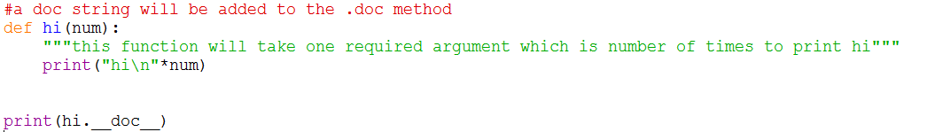
Doc String
To add a doc string, use triple double quotes
Notes:
#a doc string will be added to the .doc method
def hi(num):
"""this function will take one required argument which is number of times to print hi"""
print("hi\n"*num)
print(hi.__doc__)

Slide 9
ExerciseS
1.1 Create a function called yell(“string”) which prints out the argument in all caps and adds six exclamation points at the end
1.2 Create a function called calculate which requires you to pass in 2 numbers and prints their sum, product, difference, and quotient
1.3 Create a function called exponent which has 2 parameters. The base will be required with no default value. The power will be optional with a default value of 2
Base will be a required argument
Power will be an optional argument with default value of 2
5²= 5x5

Slide 10
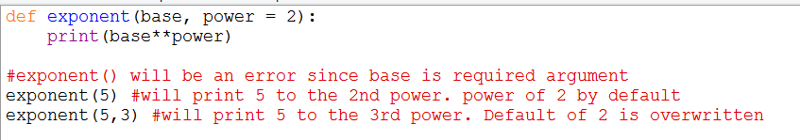
Solution 1.3
Create a function called exponent which has 2 parameters. The base will be required with no default value. The power will be optional with a default value of 2
Notes:
def exponent(base, power = 2):
print(base**power)
#exponent() will be an error since base is required argument
exponent(5) #will print 5 to the 2nd power. power of 2 by default
exponent(5,3) #will print 5 to the 3rd power. Default of 2 is overwritten

Slide 11
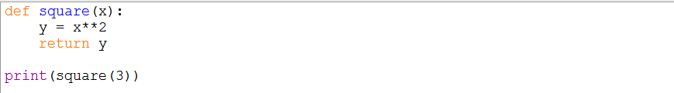
Return
So far we have used the print statement instead of return
The return statement stores the result but does not print

Slide 12
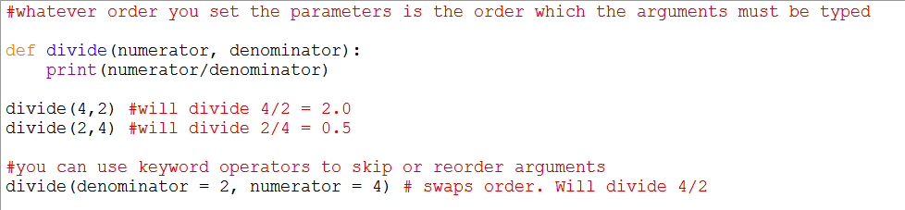
Keyword Argument
Functions can take an infinite number of parameters
Using keyword arguments can help clarify what arguments you are passing by explicitly stating each argument and can save time by skipping optional arguments
Notes:
#whatever order you set the parameters is the order which the arguments must be typed
def divide(numerator, denominator):
print(numerator/denominator)
divide(4,2) #will divide 4/2 = 2.0
divide(2,4) #will divide 2/4 = 0.5

Slide 13

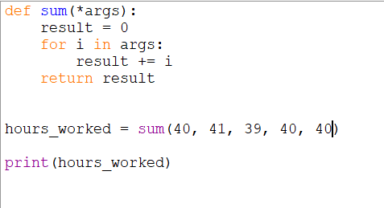
Arguments
Although functions can take an unlimited number of arguments, there is amore efficient way to write something like this
If we want the function to add numbers together but the number of arguments will vary, use *

Slide 14
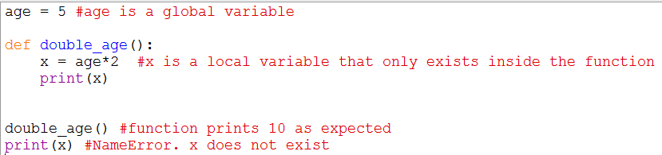
Scoping
Variables in python can only be accessed and manipulated only in certain parts of the code.

Slide 15
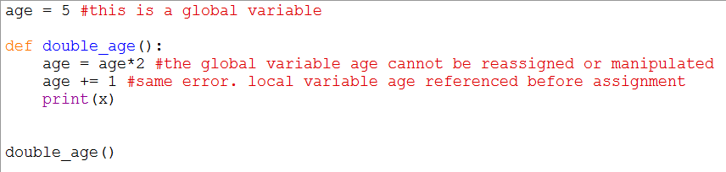
Scoping
Variables in python can only be accessed and manipulated only in certain parts of the code.
Notes:
age = 5 #this is a global variable
def double_age():
age = age*2 #the global variable age cannot be reassigned or manipulated
age += 1 #same error. local variable age referenced before assignment
print(x)
double_age()

Slide 16
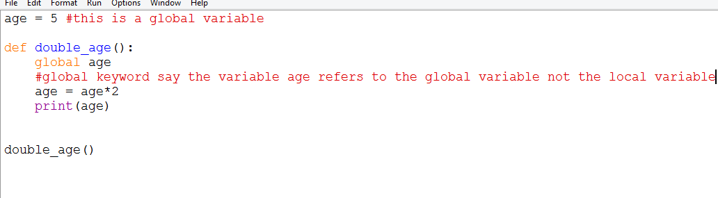
Scoping
You can use the global keyword to change the scope
Notes:
age = 5 #this is a global variable
def double_age():
global age
#global keyword say the variable age refers to the global variable not the local variable
age = age*2
print(age)
double_age()

